Slide 1
INTRODUCTION :-
The main aim of this project was to provide water to the plants or gardening automatically using microcontroller (Arduino Uno). We can automatically watering the plants when we are going on vacation or don’t we have to bother my neighbors, Sometimes the neighbors do too much of watering and the plants end up dying anyway. There are timer based devices available in India which waters the soil on set interval. They do not sense the soil moisture and the ambient temperature to know if the soil actually needs watering or not. Assimilation is that the artificial application of water to the land or soil It is used to assist in the growing of agricultural crops ,maintenance of landscapes, and re vegetation of disturbed soils in dry areas and during periods of inadequate rainfall. When a zone comes on, the water flows through the lateral lines and ultimately finally ends up at the irrigation electrode (drip) or mechanical device heads. Several sprinklers have pipe thread inlets on the lowest of them that permits a fitting and also the pipe to be connected to them. The sprinklers are usually used in the top of the head flush with the ground surface . As the method of dripping will reduce huge water losses it became a popular method by reducing the labor cost and increasing the yields. When the components are activated, all the components will read and gives the output signal to the controller, and the information will be displayed to the user (farmer). The sensor readings are analog in nature so the ADC pin in the controller will convert the analog signals into digital format . Then the controller will access information and when the motors are turned On/Off it will be displayed on the LCD Panel, and serial monitor windows . There are many systems are available to water savings in various crops, from basic ones to more technologically advanced ones. For instance, in one system plant watering status was monitored and irrigation scheduled based on temperature presents in soil content of the plant.

Slide 2
WORKING :-
An automatic plant watering system using Arduino microcontroller UNO R3 is programmed such that it gives the interrupt signals to the motor via the motor driver module. Soil sensor is connected to the A0 pin to the Arduino board which senses the moisture content present in the soil. Whenever the soil moisture content values goes down, the sensor senses the humidity change, giving signal to the microcontroller so that the pump (motor) can be activated. This concept can be used for automatic plant watering system. Irrigation is defined as artificial application of water to land or soil. Irrigation process can be used for the cultivation of agricultural crops during the span of inadequate rainfall and for maintaining landscapes. An automatic irrigation system does the operation of a system without requiring manual involvement of persons. An automatic irrigation system does the work quite efficiently and with a positive impact on the place where it is installed. Once it is installed in the agricultural field, the water distribution to crops and nurseries becomes easy and doesn’t require any human support to perform the operations permanently.

Slide 3
COMPONENTS USED:-
Arduino UNO R3
Soil Moisture Sensor
5V Relay
9V Battery
Water Pump(3V-6v)
Jumper Wires(Male To Male) (Male To Female)

Slide 4
ARDUINO UNO:-
Arduino Uno R3 is one kind of ATmega328P based microcontroller board. It includes the whole thing required to hold up the microcontroller; just attach it to a PC with the help of a USB cable, and give the supply using AC-DC adapter or a battery to get started. The term Uno means “one” in the language of “Italian” and was selected for marking the release of Arduino’s IDE 1.0 software. The R3 Arduino Uno is the 3rd as well as most recent modification of the Arduino Uno. Arduino board and IDE software are the reference versions of Arduino and currently progressed to new releases. The Uno-board is the primary in a sequence of USB-Arduino boards, & the reference model designed for the Arduino platform.

Slide 5
Arduino Uno R3 Specifications:-
The Arduino Uno R3 board includes the following specifications.
It is an ATmega328P based Microcontroller
The Operating Voltage of the Arduino is 5V
The recommended input voltage ranges from 7V to 12V
The i/p voltage (limit) is 6V to 20V
Digital input and output pins-14
Digital input & output pins (PWM)-6
Analog i/p pins are 6
DC Current for each I/O Pin is 20 mA
DC Current used for 3.3V Pin is 50 mA
Flash Memory -32 KB, and 0.5 KB memory is used by the boot loader
SRAM is 2 KB
EEPROM is 1 KB
The speed of the CLK is 16 MHz
In Built LED
Length and width of the Arduino are 68.6 mm X 53.4 mm
The weight of the Arduino board is 25 g

Slide 6
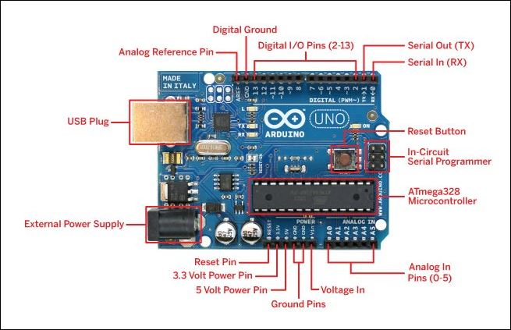
Arduino Uno R3 Pin Diagram:-
The Arduino Uno R3 pin diagram is shown below. It comprises 14-digit I/O pins. From these pins, 6-pins can be utilized like PWM outputs. This board includes 14 digital input/output pins, Analog inputs-6, a USB connection, quartz crystal-16 MHz, a power jack, a USB connection, resonator-16Mhz, a power jack, an ICSP header an RST button.
Arduino Uno Pin Diagram Arduino Uno Board

Slide 7
Power Supply:-The power supply of the Arduino can be done with the help of an exterior power supply otherwise USB connection. The exterior power supply (6 to 20 volts) mainly includes a battery or an AC to DC adapter. The connection of an adapter can be done by plugging a center-positive plug (2.1mm) into the power jack on the board. The battery terminals can be placed in the pins of Vin as well as GND. The power pins of an Arduino board include the following.
Vin:-The input voltage or Vin to the Arduino while it is using an exterior power supply opposite to volts from the connection of USB or else RPS (regulated power supply). By using this pin, one can supply the voltage.
5Volts:-The RPS can be used to give the power supply to the microcontroller as well as components which are used on the Arduino board. This can approach from the input voltage through a regulator.
3V3:-A 3.3 supply voltage can be generated with the onboard regulator, and the highest draw current will be 50 mA.
GND:-GND (ground) pins
Memory:-The memory of an ATmega328 microcontroller includes 32 KB and 0.5 KB memory is utilized for the Boot loader), and also it includes SRAM-2 KB as well as EEPROM-1KB.
Input and Output:-We know that an arguing Uno R3 includes 14-digital pins which can be used as an input otherwise output by using the functions like pin Mode (), digital Read(), and digital Write(). These pins can operate with 5V, and every digital pin can give or receive 20mA, & includes a 20k to 50k ohm pull up resistor. The maximum current on any pin is 40mA which cannot surpass for avoiding the microcontroller from the damage. Additionally, some of the pins of an Arduino include specific functions.

Slide 8
Serial Pins:-The serial pins of an Arduino board are TX (1) and RX (0) pins and these pins can be used to transfer the TTL serial data. The connection of these pins can be done with the equivalent pins of the ATmega8 U2 USB to TTL chip.
External Interrupt Pins:-The external interrupt pins of the board are 2 & 3, and these pins can be arranged to activate an interrupt on a rising otherwise falling edge, a low-value otherwise a modify in value
PWM Pins:-The PWM pins of an Arduino are 3, 5, 6, 9, 10, & 11, and gives an output of an 8-bit PWM with the function analog Write ().
SPI (Serial Peripheral Interface) Pins:-The SPI pins are 10, 11, 12, 13 namely SS, MOSI, MISO, SCK, and these will maintain the SPI communication with the help of the SPI library.
LED Pin:-An arguing board is inbuilt with a LED using digital pin-13. Whenever the digital pin is high, the LED will glow otherwise it will not glow.
TWI (2-Wire Interface) Pins:-The TWI pins are SDA or A4, & SCL or A5, which can support the communication of TWI with the help of Wire library.
AREF (Analog Reference) Pin:-An analog reference pin is the reference voltage to the inputs of an analog i/ps using the function like analog Reference().
Reset (RST) Pin:-This pin brings a low line for resetting the microcontroller, and it is very useful for using an RST button toward shields which can block the one over the Arduino R3 board.
Communication:-The communication protocols of an Arduino Uno include SPI, I2C, and UART serial communication.
UART:-An Arduino Uno uses the two functions like the transmitter digital pin1 and the receiver digital pin0. These pins are mainly used in UART TTL serial communication.

Slide 9
I2C:-An Arduino UNO board employs SDA pin otherwise A4 pin & A5 pin otherwise SCL pin is used for I2C communication with wire library. In this, both the SCL and SDA are CLK signal and data signal.
SPI Pins:-The SPI communication includes MOSI, MISO, and SCK.
MOSI (Pin11):-This is the master out slave in the pin, used to transmit the data to the devices
MISO (Pin12):-This pin is a serial CLK, and the CLK pulse will synchronize the transmission of which is produced by the master.
SCK (Pin13):-The CLK pulse synchronizes data transmission that is generated by the master. Equivalent pins with the SPI library is employed for the communication of SPI. ICSP (in-circuit serial programming) headers can be utilized for programming Atmega microcontroller directly with the boot loader.
Arduino Uno R3 Programming:-
The programming of an Arduino Uno R3 can be done using IDE software. The microcontroller on the board will come with pre-burned by a boot loader that permits to upload fresh code without using an exterior hardware programmer.
The communication of this can be done using a protocol like STK500.
We can also upload the program in the microcontroller by avoiding the boot loader using the header like the In-Circuit Serial Programming.

Slide 10
Soil moisture sensor:-
Soil moisture sensors measure the volumetric water content in soil. Since the direct gravimetric measurement of free soil moisture requires removing, drying, and weighing of a sample, soil moisture sensors measure the volumetric water content indirectly by using some other property of the soil, such as electrical resistance, dielectric constant, or interaction with neutrons, as a proxy for the moisture content.
The relation between the measured property and soil moisture must be calibrated and may vary depending on environmental factors such as soil type, temperature, or electric conductivity Reflected microwave radiation is affected by the soil moisture and is used for remote sensing in hydrology and agriculture. Portable probe instruments can be used by farmers or gardeners.
Soil moisture sensors typically refer to sensors that estimate volumetric water content. Another class of sensors measure another property of moisture in soils called water potential; these sensors are usually referred to as soil water potential sensors and include tensiometers and gypsum blocks.
Application Of Soil Moisture Sensor:-
1.Agriculture:-Measuring soil moisture is important for agricultural applications to help farmers manage their irrigation systems more efficiently. Knowing the exact soil moisture conditions on their fields, not only are farmers able to generally use less water to grow a crop, they are also able to increase yields and the quality of the crop by improved management of soil moisture during critical plant growth stages.
2.Research:-Soil moisture sensors are used in numerous research applications, e.g. in agricultural science and horticulture including irrigation planning, climate research, or environmental science including solute transport studies and as auxiliary sensors for soil respiration measurements.

Slide 11
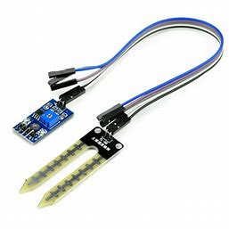
3.Landscape irrigation:-In urban and suburban areas, landscapes and residential lawns are using soil moisture sensors to interface with an irrigation controller. Connecting a soil moisture sensor to a simple irrigation clock will convert it into a "smart" irrigation controller that prevents irrigation cycles when the soil is already wet, e.g. following a recent rainfall event. Golf courses are using soil moisture sensors to increase the efficiency of their irrigation systems to prevent over-watering and leaching of fertilizers and other chemicals into the ground.
4.Simple sensors for gardeners:-Relatively cheap and simple devices that do not require a power source are available for checking whether plants have sufficient moisture to thrive. After inserting a probe into the soil for approximately 60 seconds, a meter indicates if the soil is too dry, moist or wet for plants.
Soil moisture sensor

Slide 12
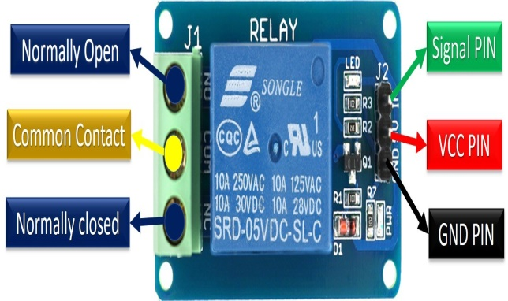
5V RELAY:-
Relay Pin Configuration:
Pin Number | Pin Name | Description
1 | Coil End 1 | Used to trigger(On/Off) the Relay, Normally one end is connected to 5V and the other end to ground
2 | Coil End 2 | Used to trigger(On/Off) the Relay, Normally one end is connected to 5V and the other end to ground
3 | Common (COM) | Common is connected to one End of the Load that is to be controlled
4 | Normally Close (NC) | The other end of the load is either connected to NO or NC. If connected to NC the load remains connected before trigger
5 | Normally Open (NO) | The other end of the load is either connected to NO or NC. If connected to NO the load remains disconnected before trigger
Features of 5-Pin 5V Relay:-
Trigger Voltage (Voltage across coil) : 5V DC
Trigger Current (Nominal current) : 70mA
Maximum AC load current: 10A @ 250/125V AC
Maximum DC load current: 10A @ 30/28V DC
Compact 5-pin configuration with plastic moulding
Operating time: 10msec Release time: 5msec
Maximum switching: 300 operating/minute (mechanically)

Slide 13
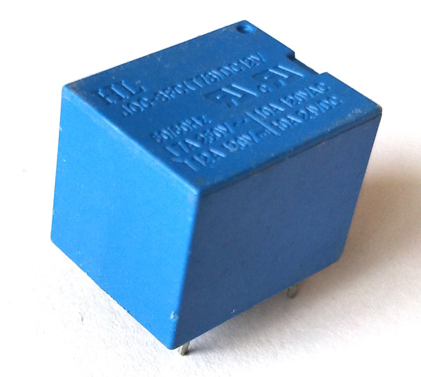
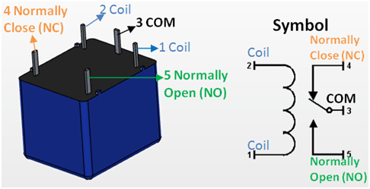
5V 5-Pin Relay Module
5V Relay Pin Diagram
use a Relay:- Relays are most commonly used switching device in electronics. Let us learn how to use one in our circuits based on the requirement of our project.Before we proceed with the circuit to drive the relay we have to consider two important parameter of the relay. Once is the Trigger Voltage, this is the voltage required to turn on the relay that is to change the contact from Common->NC to Common->NO. Our relay here has 5V trigger voltage, but you can also find relays of values 3V, 6V and even 12V so select one based on the available voltage in your project. The other parameter is your Load Voltage & Current, this is the amount of voltage or current that the NC,NO or Common terminal of the relay could withstand, in our case for DC it is maximum of 30V and 10A. Make sure the load you are using falls into this range.
The above circuit shows a bare-minimum concept for a relay to operate. Since the relay has 5V trigger voltage we have used a +5V DC supply to one end of the coil and the other end to ground through a switch. This switch can be anything from a small transistor to a microcontroller or a microprocessor which can perform switching operating. You can also notice a diode connected across the coil of the relay, this diode is called the Fly back Diode. The purpose of the diode is to protect the switch from high voltage spike that can produced by the relay coil. As shown one end of the load can be connected to the Common pin and the other end is either connected to NO or NC. If connected to NO the load remains disconnected before trigger and if connected to NC the load remains connected before trigger.

Slide 14
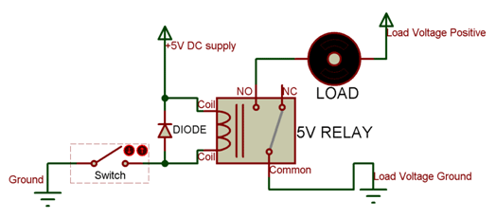
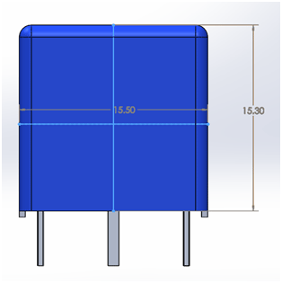
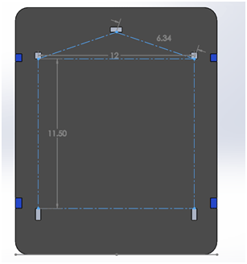
Applications of Relay:-
Commonly used in switching circuits.
For Home Automation projects to switch AC loads
To Control (On/Off) Heavy loads at a pre-determined time/condition
Used in safety circuits to disconnect the load from supply in event of failure
Used in Automobiles electronics for controlling indicators glass motors etc.
2D model of the Relay:-

Slide 15
9v Battery:-
The nine-volt battery, or 9-volt battery, is a common size of battery that was introduced for the early transistor radios. It has a rectangular prism shape with rounded edges and a polarized snap connector at the top. This type is commonly used in smoke detectors, gas detectors, clocks, walkie-talkies, electric guitars and effects units.
The nine-volt battery format is commonly available in primary carbon-zinc and alkaline chemistry, in primary lithium iron disulfide, and in rechargeable form in nickel-cadmium, nickel-metal hydride and lithium-ion. Mercury-oxide batteries of this format, once common, have not been manufactured in many years due to their mercury content. Designations for this format include NEDA 1604 and IEC 6F22 (for zinc-carbon) or MN1604 6LR61 (for alkaline). The size, regardless of chemistry, is commonly designated PP3—a designation originally reserved solely for carbon-zinc, or in some countries, E or E-block.
Most nine-volt alkaline batteries are constructed of six individual 1.5 V LR61 cells enclosed in a wrapper.These cells are slightly smaller than LR8D425 AAAA cells and can be used in their place for some devices, even though they are 3.5 mm shorter. Carbon-zinc types are made with six flat cells in a stack, enclosed in a moisture-resistant wrapper to prevent drying. Primary lithium types are made with three cells in series.
9-volt batteries accounted for 4% of alkaline primary battery sales in the United States in 2007, and 2% of primary battery sales and 2% of secondary battery (rechargeable) sales in Switzerland in 2008.

Slide 16
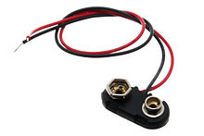
Connectors Of 9V Volts Battery:-The battery has both terminals in a snap connector on one end. The smaller circular (male) terminal is positive, and the larger hexagonal or octagonal (female) terminal is the negative contact. The connectors on the battery are the same as on the load device; the smaller one connects to the larger one and vice versa. The same snap-style connector is used on other battery types in the Power Pack(PP) series. Battery polarization is normally obvious, since mechanical connection is usually only possible in one configuration.
A problem with this style of connector is that it is very easy to connect two batteries together in a short circuit, which quickly discharges both batteries, generating heat and possibly a fire .Because of this hazard, nine-volt batteries should be kept in the original packaging until they are going to be used.
Nine-volt battery snap
9-volt battery

Slide 17
Mini Water Pump 3-6V:-This is a low cost mini submersible type water pump that works on 3-6V DC. It is extremely simple and easy to use. Just immerse the pump in water, connect a suitable pipe to the outlet and power the motor with 3-6V to start pumping water. Great for building science projects, fire-extinguishers, fire fighting robots, fountains, waterfalls, plant watering systems etc. This motor is small, compact and light. It can be controlled from a micro controller/Arduino using our DC Motor Drivers or one of our Relay Boards. You may use our 5V SMPS Power Supply Adapter to run this pump. You may also use our 6V Solar Panel to run the pump with appropriate a 6V voltage regulator.
Features Of Mini Water Pump:-
Operating DC Voltage: 2.5-6V
Maximum Water lift height: 40-110cm / 15.75"-43.4"
Flow rate: 80-120L/H
Outer Diameter of Water Outlet: 7.5mm / 0.3"
Inside Diameter of Water Outlet: 5mm / 0.2"
Pump Diameter: Approx. 24mm / 0.95"
Pump Length: Approx. 45mm / 1.8"
Pump Height: Approx. 30mm / 1.2"
Wire Length: ~13mm cm

Slide 18
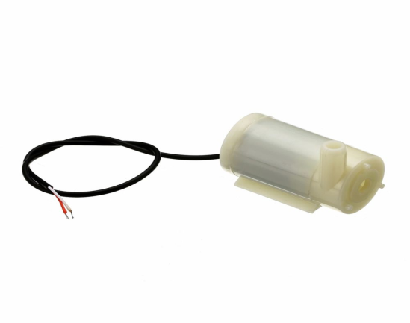
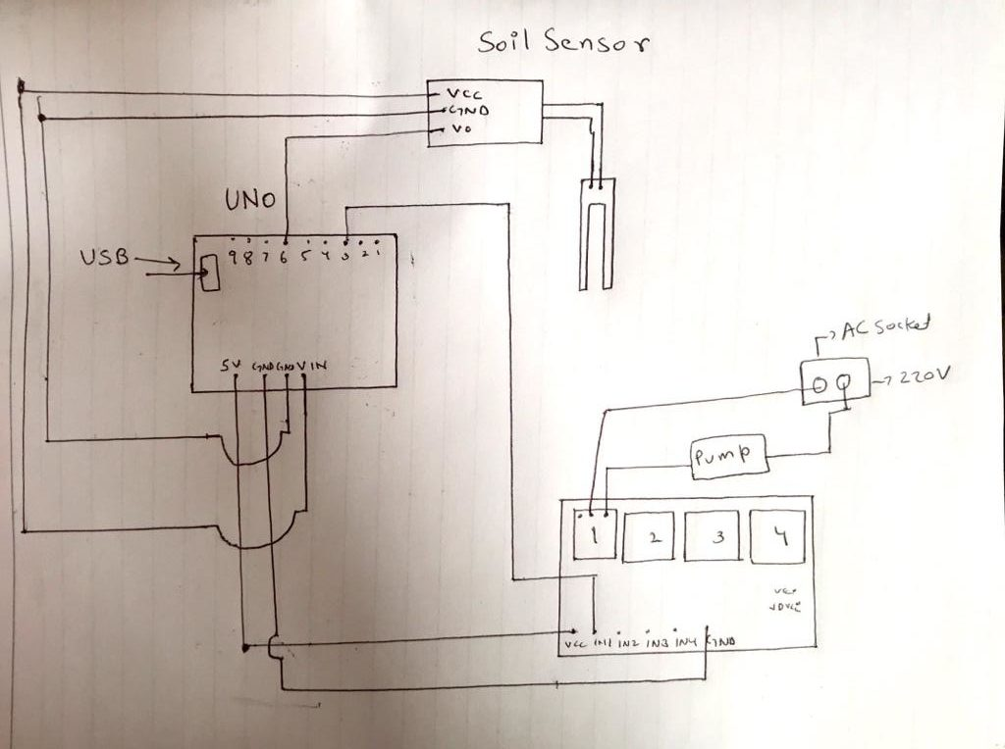
Applications:-Great for building science projects, fire-extinguishers, fire fighting robots, fountains, waterfalls, plant watering systems etc.
Controlled fountain water flow
Controlled Garden watering systems
Hydroponic Systems
Fresh water intake or exhaust systems for fish aquqrium
Mini Water Pump 3-6V
CIRCUIR DIAGRAM:-

Slide 19
Advantages of Automatic Irrigation Systems:- One of the most obvious advantages is the time savings afforded by an automatic sprinkler or drip irrigation system. Once installed, many systems can be set to a timer to water at specific time intervals and on certain days of the week. This means there’s no need to worry about forgetting to water the lawn and coming back from vacation to find crisp, yellow grass.
Another advantage is that irrigation systems, particularly the drip type, can be positioned so that water is more effectively targeted where it is needed. Nozzles can be adjusted, and underground drip tubes will deliver water right to the roots, rather than spraying walkways and driveways.
Disadvantages of Automatic Irrigation Systems:- The primary disadvantage associated with a sprinkler system is the expense. These systems can be quite costly depending on the size of the property. Furthermore, portions of the lawn will have to be dug up to install pipework and attach it to the plumbing system of the home. This can equate to days or weeks without use of the yard. Afterward, the landscaping will have to be repaired.
It is best to install an irrigation system before installing sod or extensive landscaping because some of it will have to be torn up. Homeowners who already have pristine yards may be turned off by this reality.
Even the most efficient sprinkler systems can have their pitfalls. Wind can wreak havoc on sprinklers, directing water in the wrong direction. Underground pests may damage water-delivery systems, resulting in water pooling or broken parts. The repairs to fix an irrigation system can be much more costly than replacing a damaged garden hose.
Irrigation systems have their advantages and disadvantages, and homeowners should weigh their options before installing a new system.

Slide 20
CONCLUSION:-

